Slide 1
Spatio-temporal index standardization for survey data
James Thorson

Slide 2
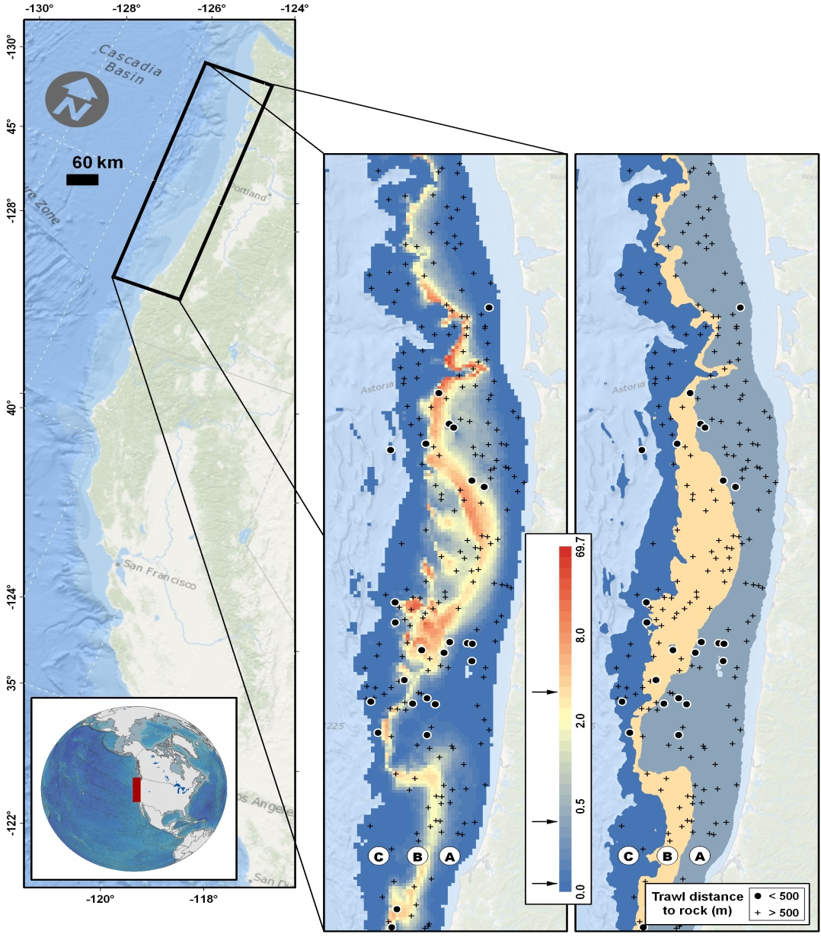
Context
Geostatistical models are useful!
Capture fine-scale variation
Decrease residual variation -> Decrease standard errors
Shelton Thorson Ward Feist (2014) CJFAS

Slide 3
Geostatistical tool
Vector autoregressive spatio-temporal model
Package VAST on GitHub
Linked via www.FishStats.org
Associated list-serve @ FishStats-listserv
Professional development
Version-control
Continuous integration
Wiki
Rmarkdown tutorial
R help (“.Rd files”) using Doxygen

Slide 4
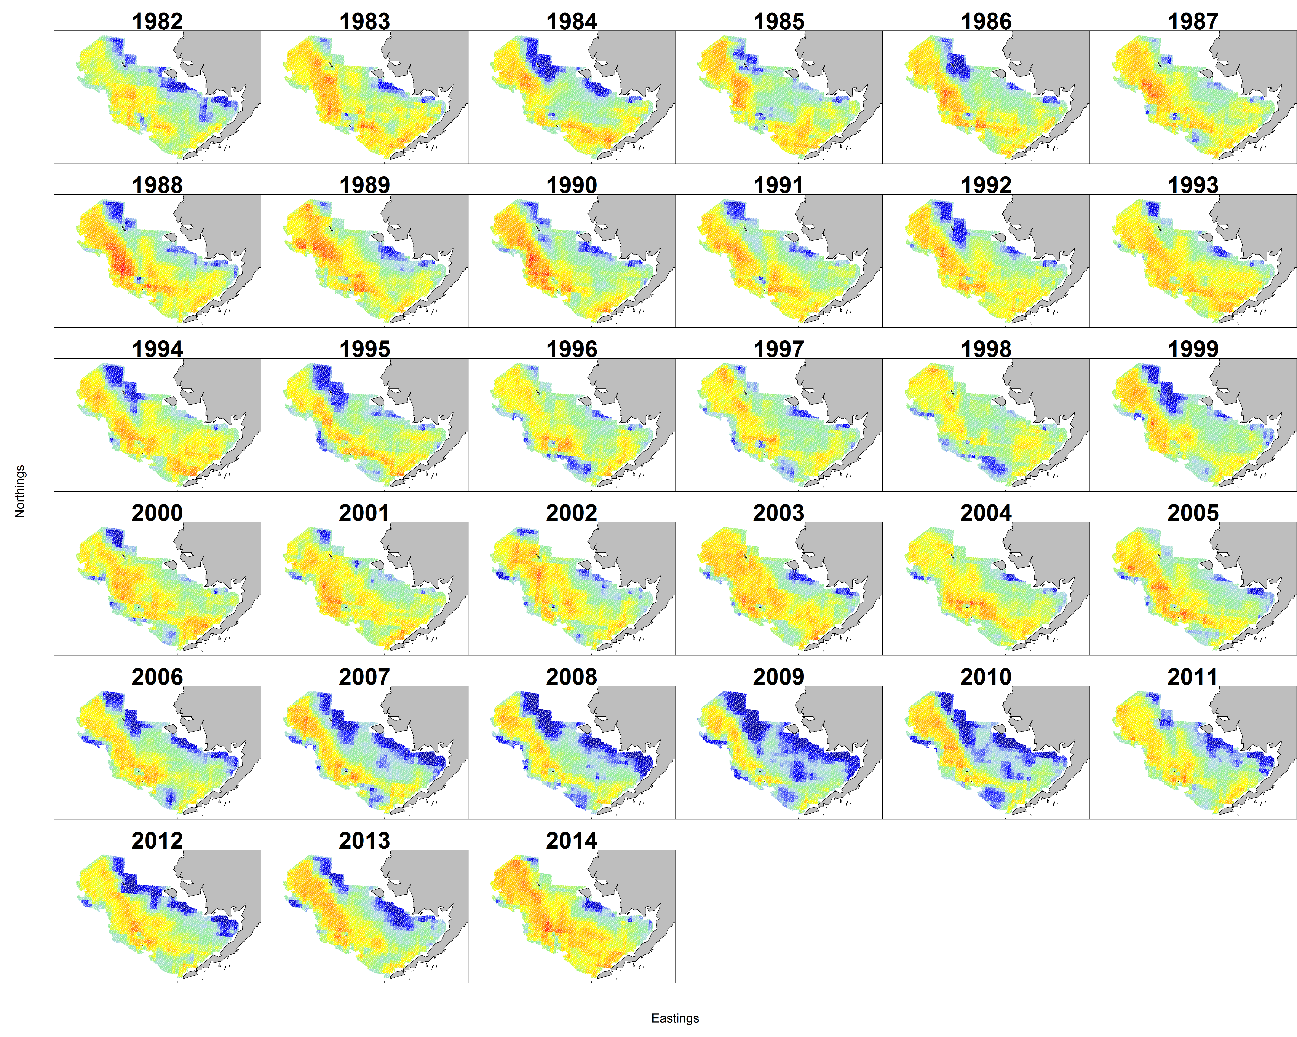
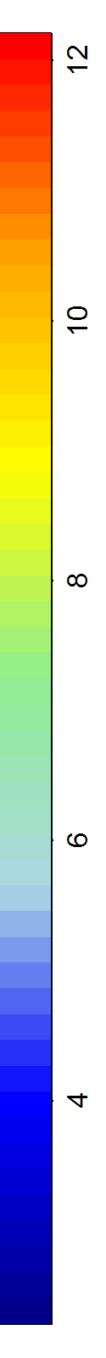
Walleye pollock in Eastern Bering Sea
(density, log kg. per square km.)

Slide 5
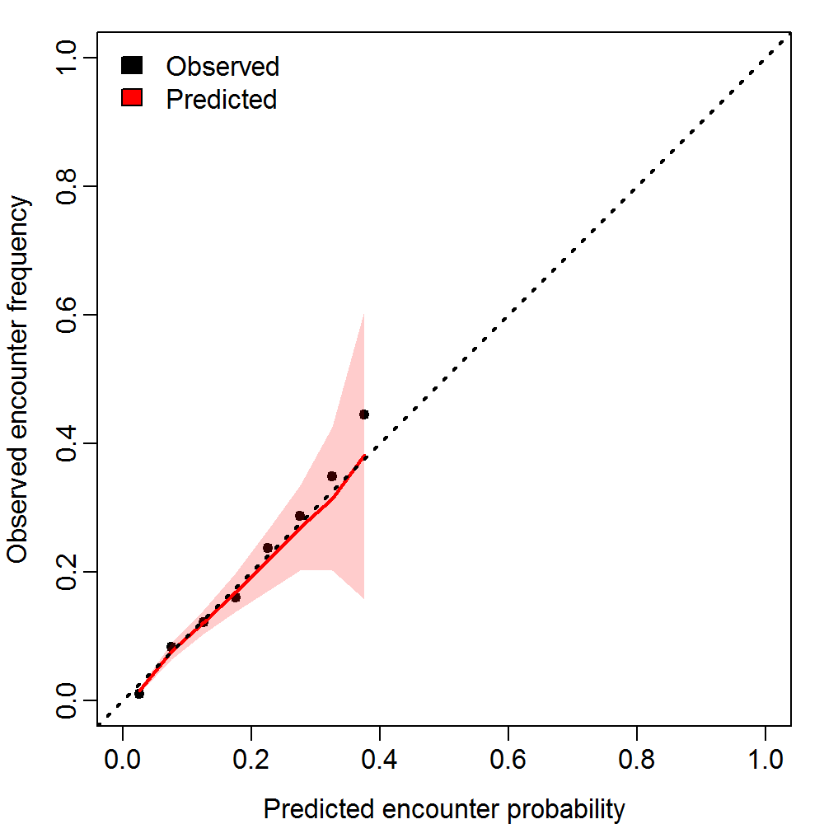
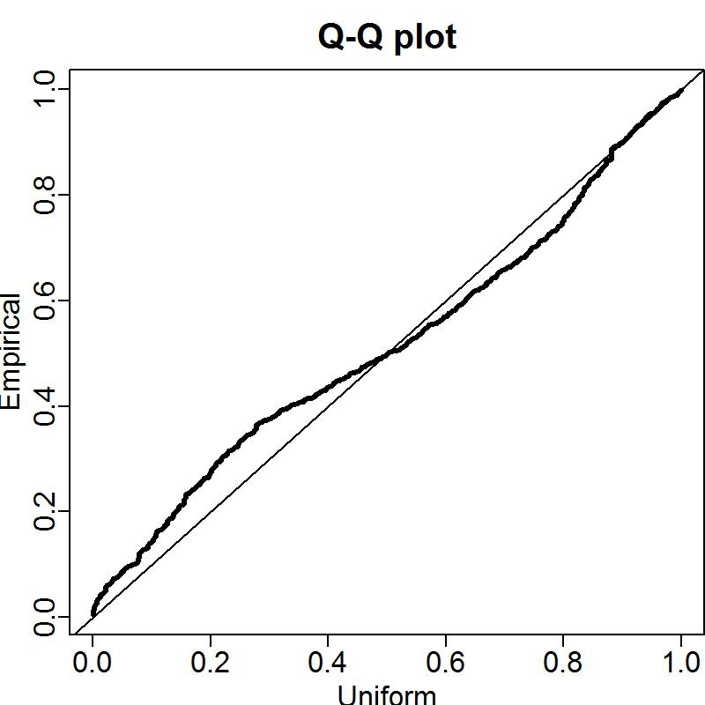
Geostatistical tool
Encounter probability vs. frequency
Quantile-quantile plot for positive catch rates

Slide 6
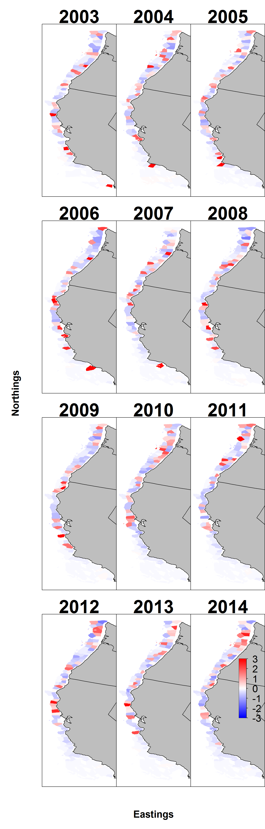
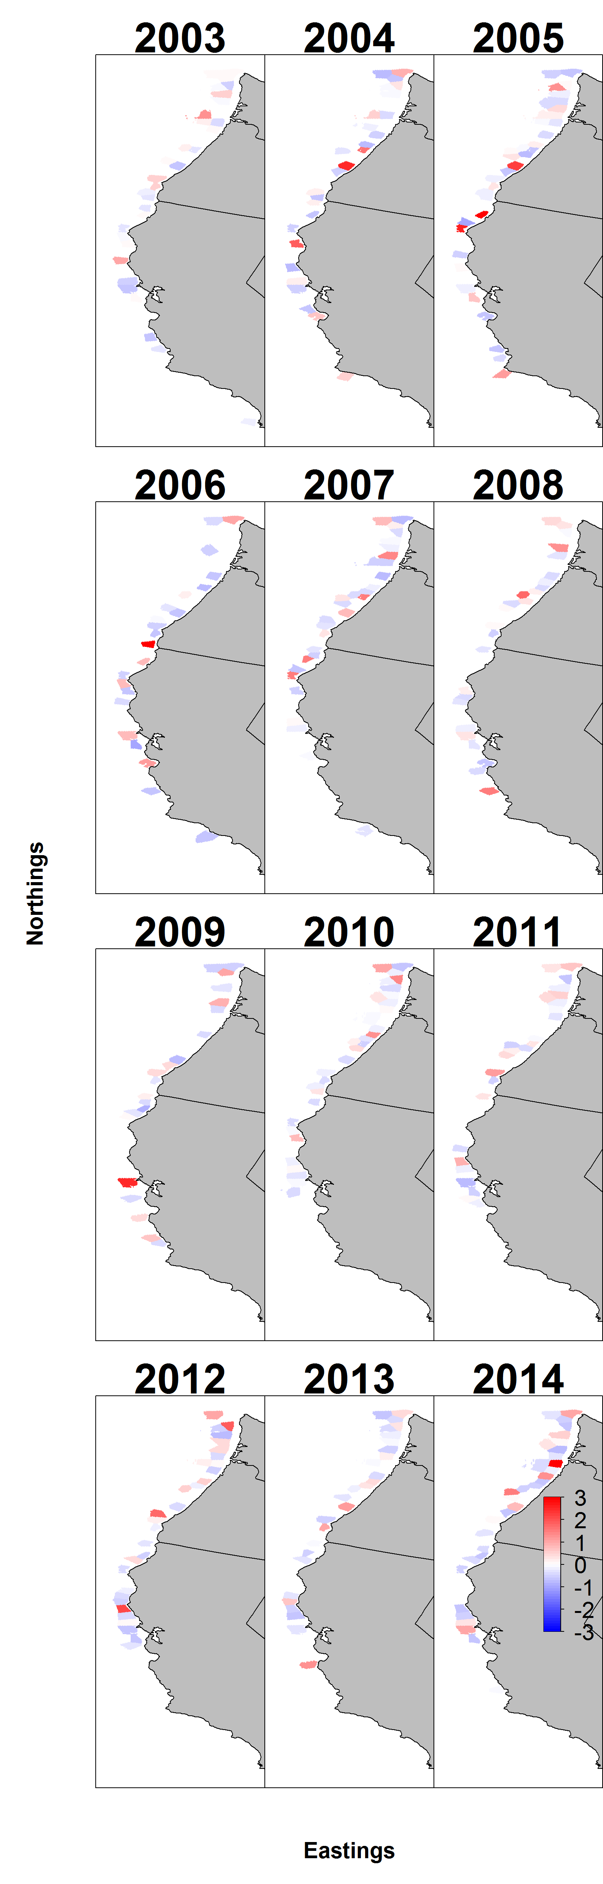
Pearson residuals for encounter
Pearson residuals for positive catch rates

Slide 7
Geostatistical tool
Real-world application
Apply to 28 West Coast species
Test set in Thorson and Ward (2013, 2014)
Compare with Bayesian delta-GLMM

Slide 8
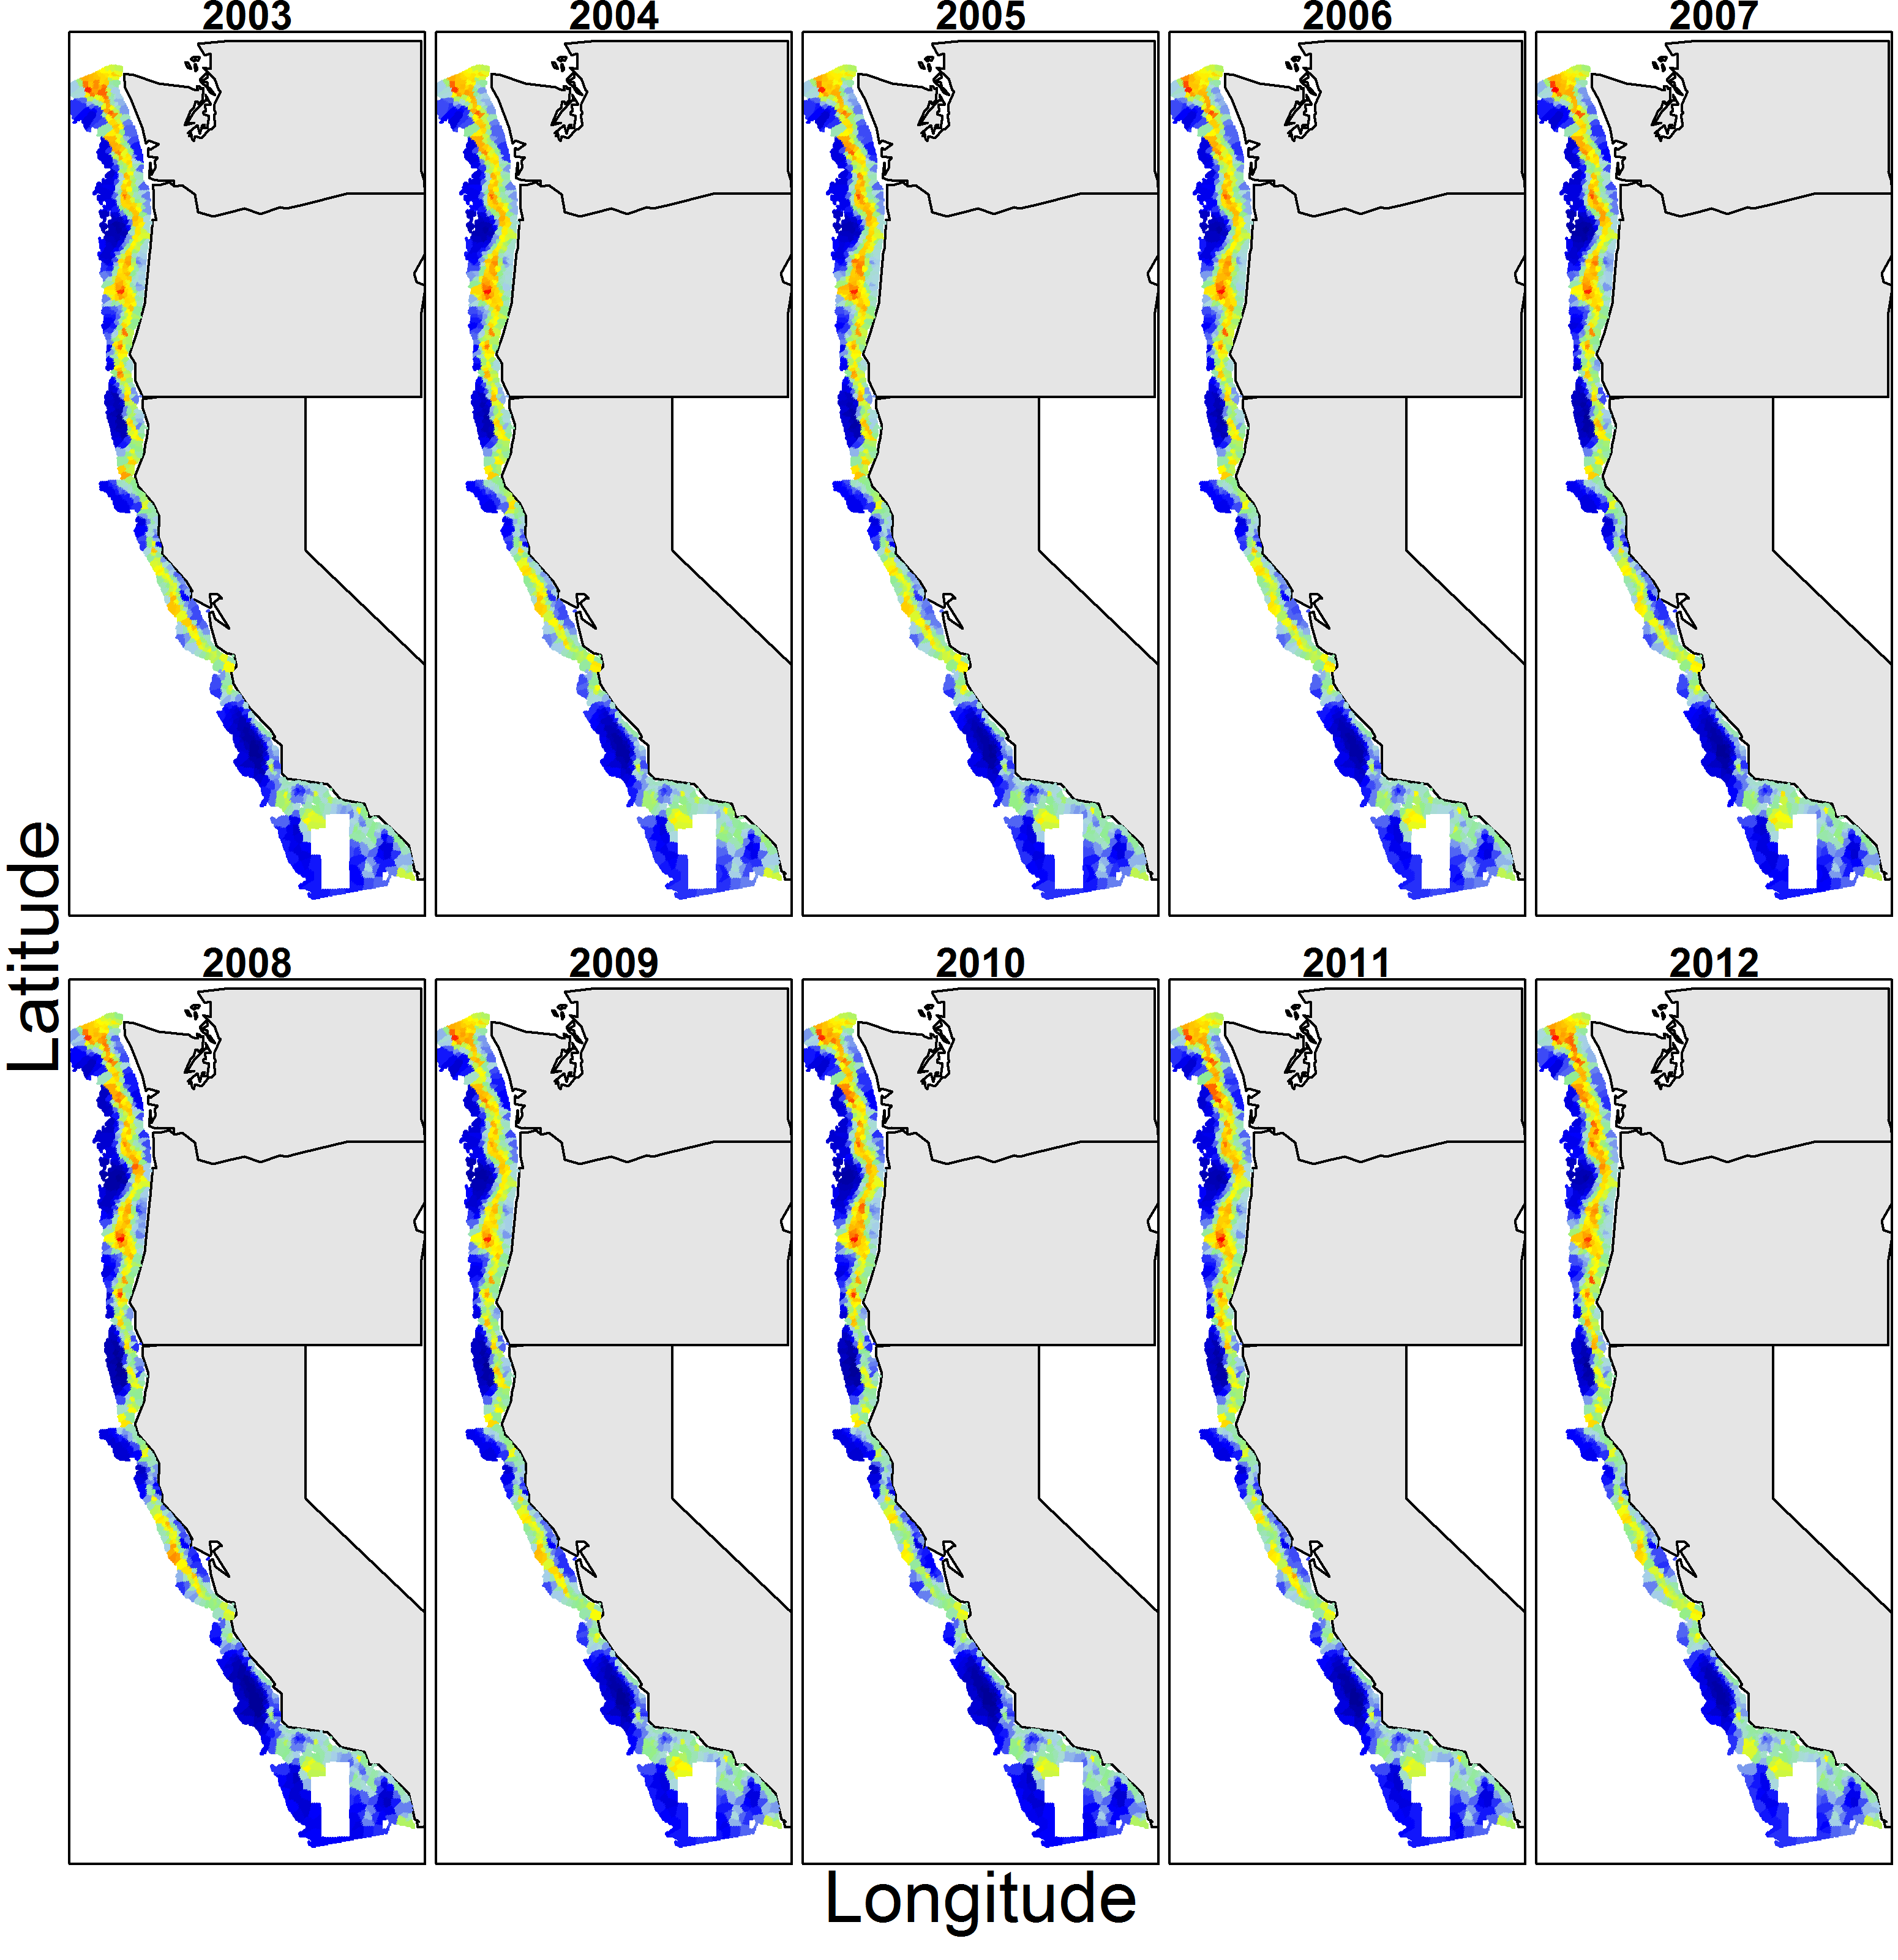
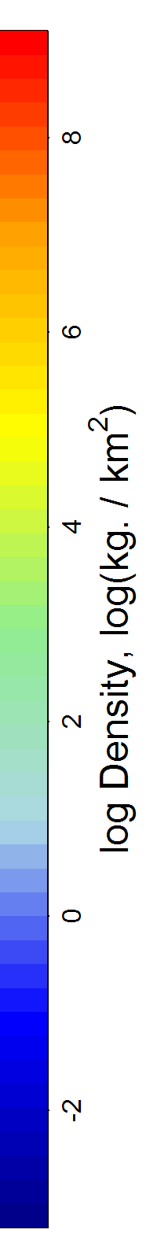
Geostatistical tool
Example – Greenstriped rockfish density

Slide 9
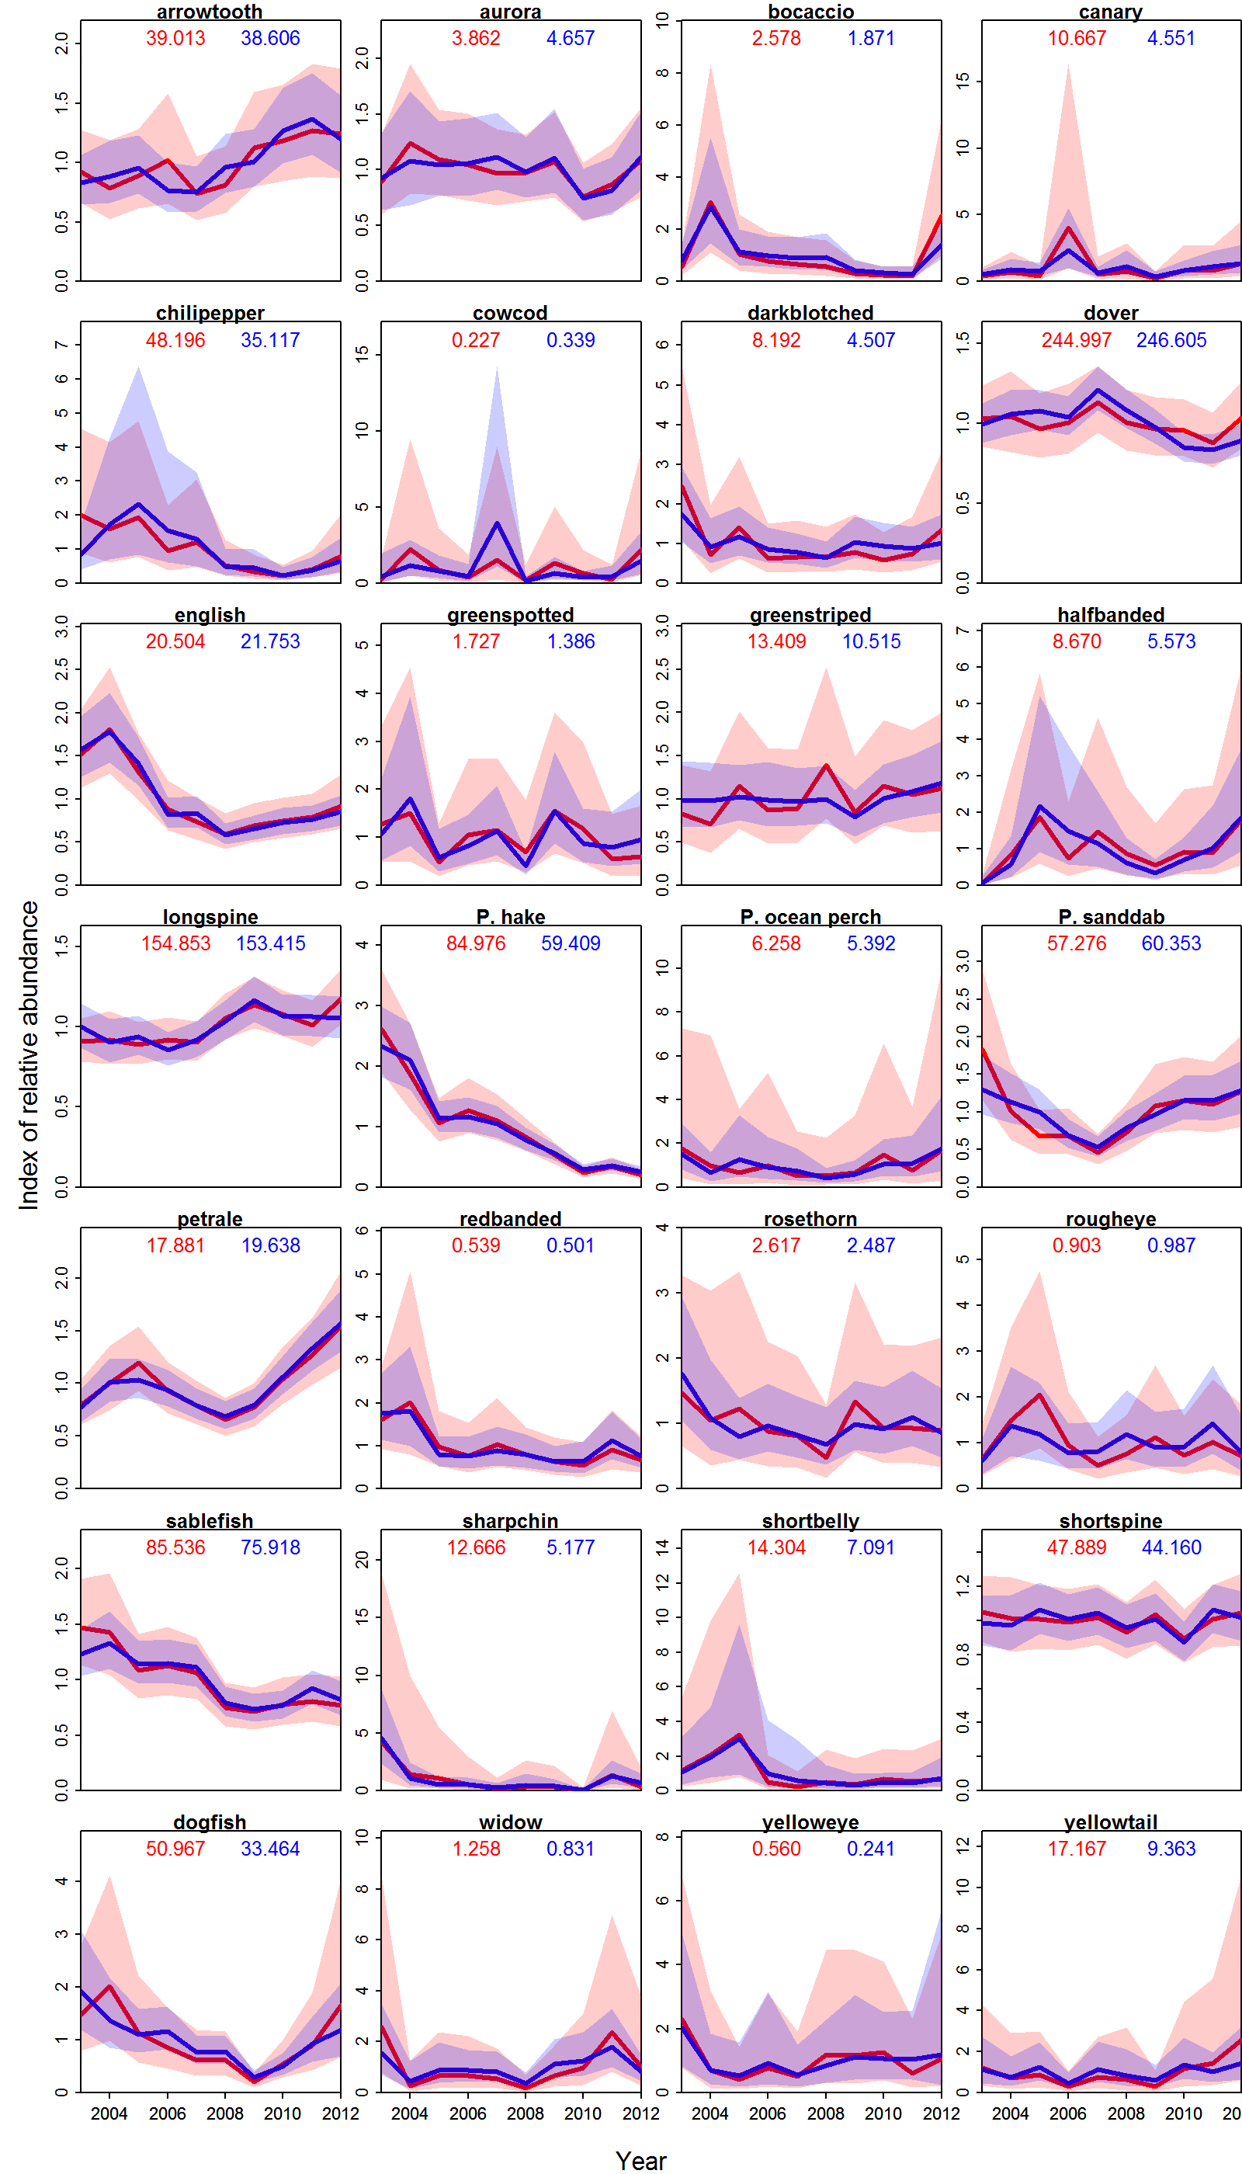
Geostatistical and stratified give similar trends

Slide 10
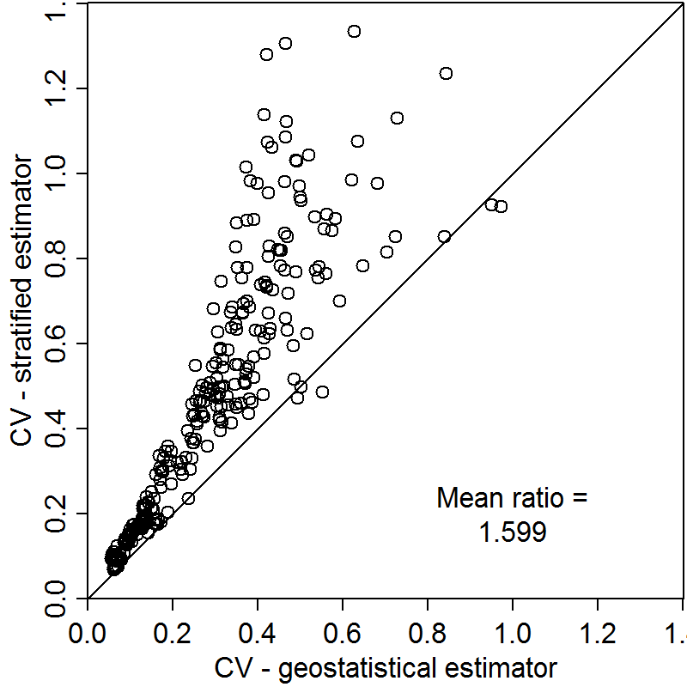
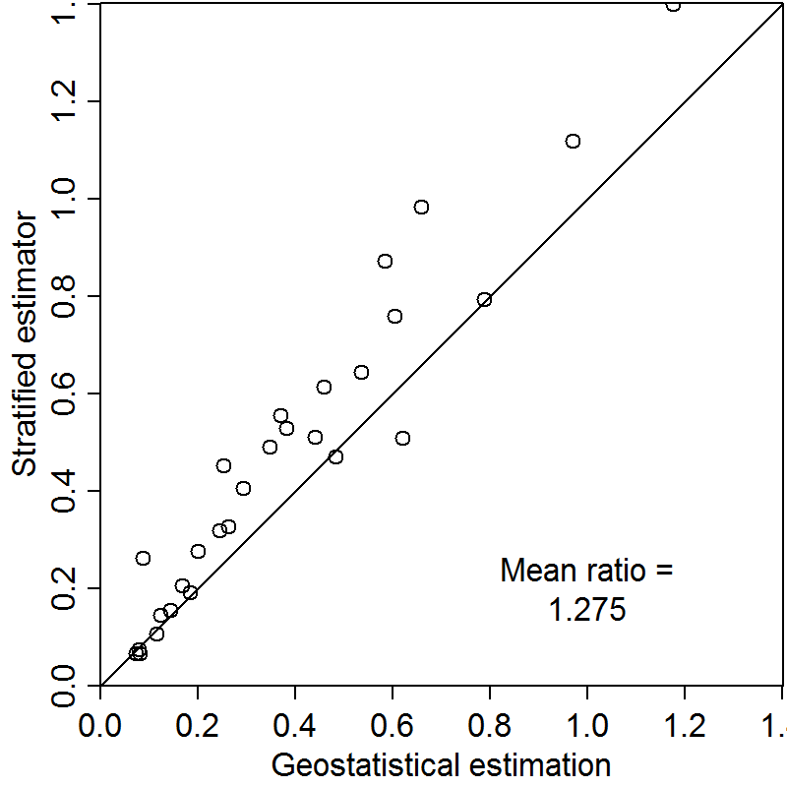
Geostatistical gives smaller interval estimates
Also has smaller interannual variability
Interval estimates
Interannual variability

Slide 11
Acknowledgements
Co-authors:
Ole Shelton, Eric Ward, Hans Skaug
Computing tools:
TMB: Kasper Kristensen (!!!)

Slide 12
Geostatistical tool
Define spatial locations for approximation
Analyst chooses number of knots
I’ll show 500/1000
Software determine location for knots
I’ll use a k-means algorithm based on the 40,000 grid cells for coast-wide survey coverage
Software assigns each sample to nearest “knot”
Generate Voronoi mapping of continuous coast-wide sampling domain

Slide 13
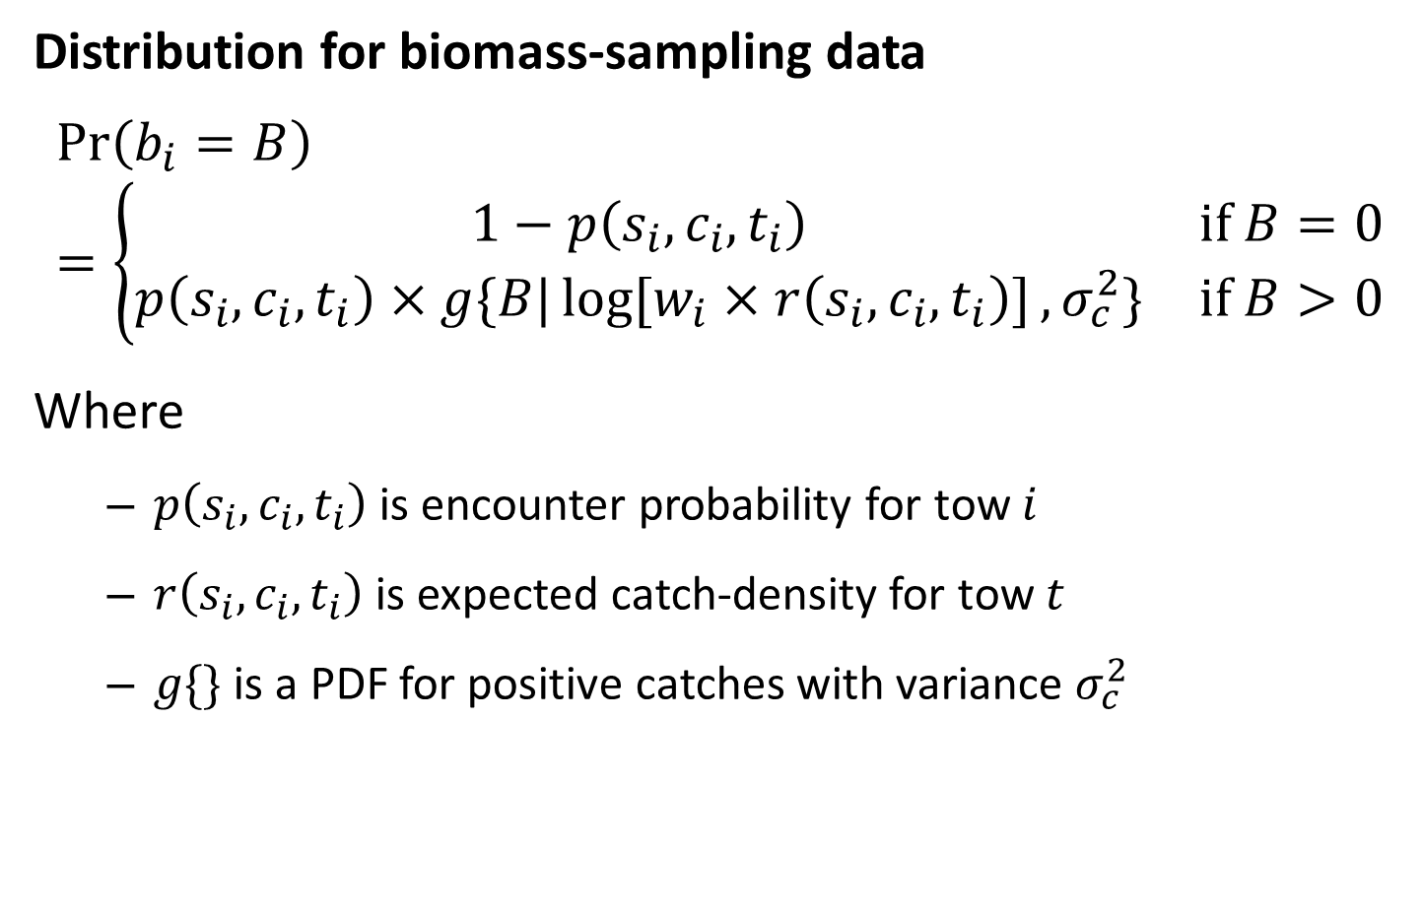
Geostatistical tool
Distribution for biomass-sampling data
$$\operatorname{Pr}\left(b_{i}=B\right)=\left\{\begin{matrix}1−p\left(s_{i},c_{i},t_{i}\right) & if B=0 \\ p\left(s_{i},c_{i},t_{i}\right)×g\{\left.B|\log{[\left.w_{i}×r\left(s_{i},c_{i},t_{i}\right)]\right.},σ_{c}^{2}\}\right. & if B>0\end{matrix}\right.$$
Where
$p\left(s_{i},c_{i},t_{i}\right)$ is encounter probability for tow $i$
$r\left(s_{i},c_{i},t_{i}\right)$ is expected catch-density for tow $t$
$g\{\}$ is a PDF for positive catches with variance $σ_{c}^{2}$

Slide 14
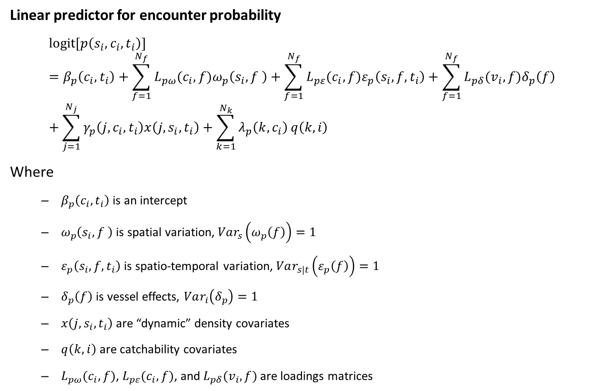
Geostatistical tool
Linear predictor for encounter probability
$$\operatorname{logit}{[\left.p\left(s_{i},c_{i},t_{i}\right)]\right.}=β_{p}\left(c_{i},t_{i}\right)+\sum_{f=1}^{N_{f}}{L_{pω}(c_{i}, f)ω_{p}\left(s_{i},f \right)}+\sum_{f=1}^{N_{f}}{L_{pε}(c_{i}, f)ε_{p}\left(s_{i},f,t_{i}\right)}+\sum_{f=1}^{N_{f}}{L_{pδ}(v_{i},f)δ_{p}\left(f\right)}+\sum_{j=1}^{N_{j}}{γ_{p}\left(j,c_{i}, t_{i}\right)x\left(j,s_{i},t_{i}\right)+\sum_{k=1}^{N_{k}}{λ_{p}\left(k,c_{i}\right)}q\left(k,i\right)}$$
Where
$β_{p}\left(c_{i},t_{i}\right)$ is an intercept
$ω_{p}\left(s_{i},f \right)$ is spatial variation, $Var_{s}\left(ω_{p}\left(f\right)\right)=1$
$ε_{p}\left(s_{i},f,t_{i}\right)$ is spatio-temporal variation, $Var_{s|t}\left(ε_{p}\left(f\right)\right)=1$
$δ_{p}\left(f\right)$ is vessel effects, $Var_{i}\left(δ_{p}\right)=1$
$x\left(j,s_{i},t_{i}\right)$ are “dynamic” density covariates
$q\left(k,i\right)$ are catchability covariates
$L_{pω}(c_{i}, f)$, $L_{pε}(c_{i}, f)$, and $L_{pδ}(v_{i},f)$ are loadings matrices

Slide 15
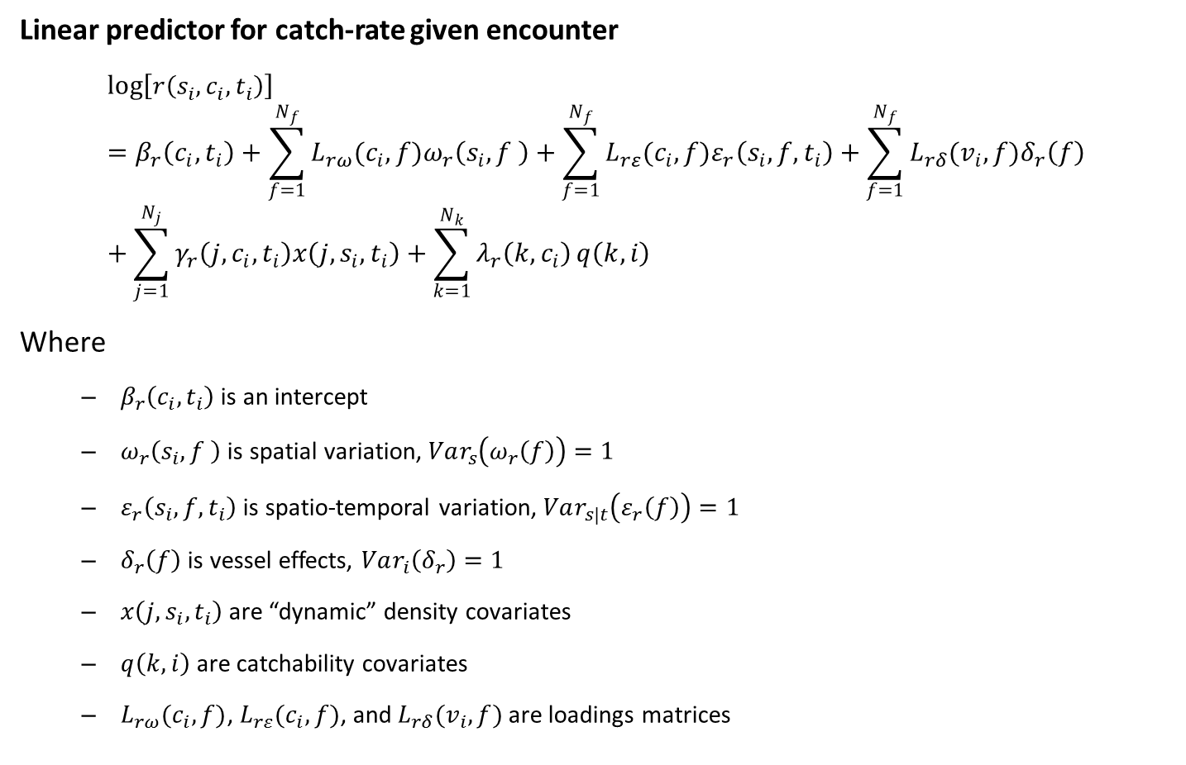
Geostatistical tool
Linear predictor for catch-rate given encounter
$$\log\left[r\left(s_{i},c_{i},t_{i}\right)\right]=β_{r}\left(c_{i},t_{i}\right)+\sum_{f=1}^{N_{f}}{L_{rω}(c_{i}, f)ω_{r}\left(s_{i},f \right)}+\sum_{f=1}^{N_{f}}{L_{rε}(c_{i}, f)ε_{r}\left(s_{i},f,t_{i}\right)}+\sum_{f=1}^{N_{f}}{L_{rδ}(v_{i},f)δ_{r}\left(f\right)}+\sum_{j=1}^{N_{j}}{γ_{r}\left(j,c_{i}, t_{i}\right)x\left(j,s_{i},t_{i}\right)+\sum_{k=1}^{N_{k}}{λ_{r}\left(k,c_{i}\right)}q\left(k,i\right)}$$
Where
$β_{r}\left(c_{i},t_{i}\right)$ is an intercept
$ω_{r}\left(s_{i},f \right)$ is spatial variation, $Var_{s}\left(ω_{r}\left(f\right)\right)=1$
$ε_{r}\left(s_{i},f,t_{i}\right)$ is spatio-temporal variation, $Var_{s|t}\left(ε_{r}\left(f\right)\right)=1$
$δ_{r}\left(f\right)$ is vessel effects, $Var_{i}\left(δ_{r}\right)=1$
$x\left(j,s_{i},t_{i}\right)$ are “dynamic” density covariates
$q\left(k,i\right)$ are catchability covariates
$L_{rω}(c_{i}, f)$, $L_{rε}(c_{i}, f)$, and $L_{rδ}(v_{i},f)$ are loadings matrices

Slide 16
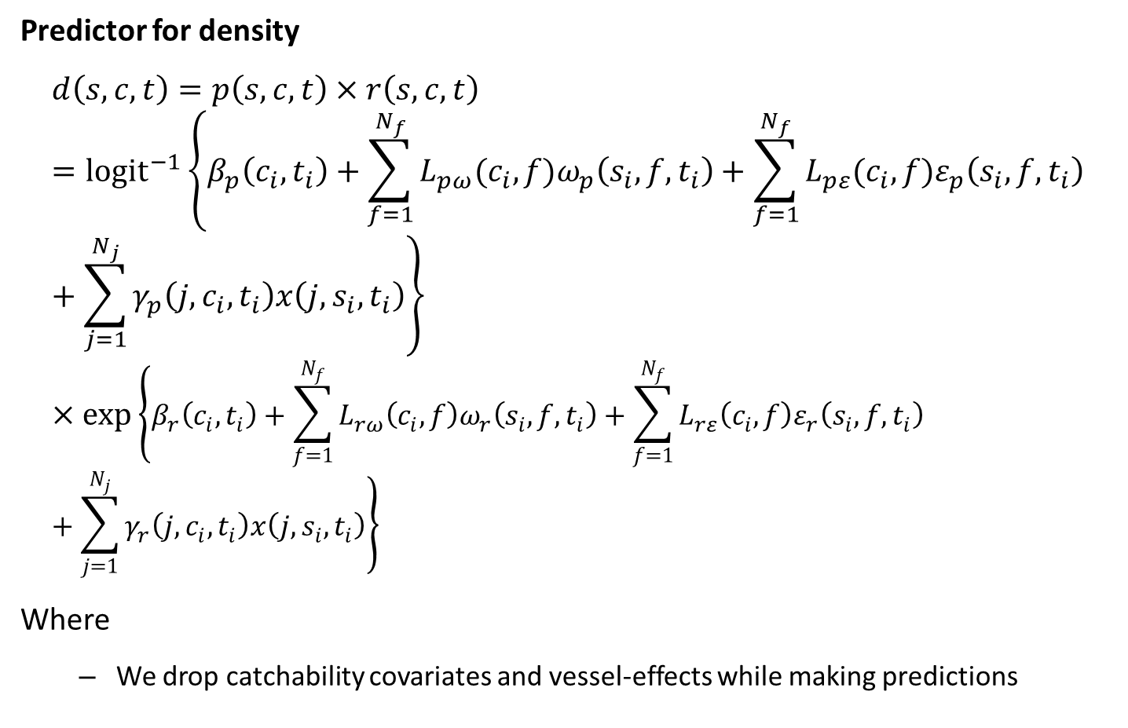
Geostatistical tool
Predictor for density
$$d\left(s,c,t\right)=p\left(s,c,t\right)×r\left(s,c,t\right)={logit}^{−1}\left\{β_{p}\left(c_{i},t_{i}\right)+\sum_{f=1}^{N_{f}}{L_{pω}(c_{i}, f)ω_{p}\left(s_{i},f,t_{i}\right)}+\sum_{f=1}^{N_{f}}{L_{pε}(c_{i}, f)ε_{p}\left(s_{i},f,t_{i}\right)}+\sum_{j=1}^{N_{j}}{γ_{p}\left(j,c_{i}, t_{i}\right)x\left(j,s_{i},t_{i}\right)}\right\}×\exp\left\{β_{r}\left(c_{i},t_{i}\right)+\sum_{f=1}^{N_{f}}{L_{rω}\left(c_{i}, f\right)ω_{r}\left(s_{i},f,t_{i}\right)}+\sum_{f=1}^{N_{f}}{L_{rε}\left(c_{i}, f\right)ε_{r}\left(s_{i},f,t_{i}\right)}+\sum_{j=1}^{N_{j}}{γ_{r}\left(j,c_{i}, t_{i}\right)x\left(j,s_{i},t_{i}\right)}\right\}$$
Where
We drop catchability covariates and vessel-effects while making predictions

Slide 17
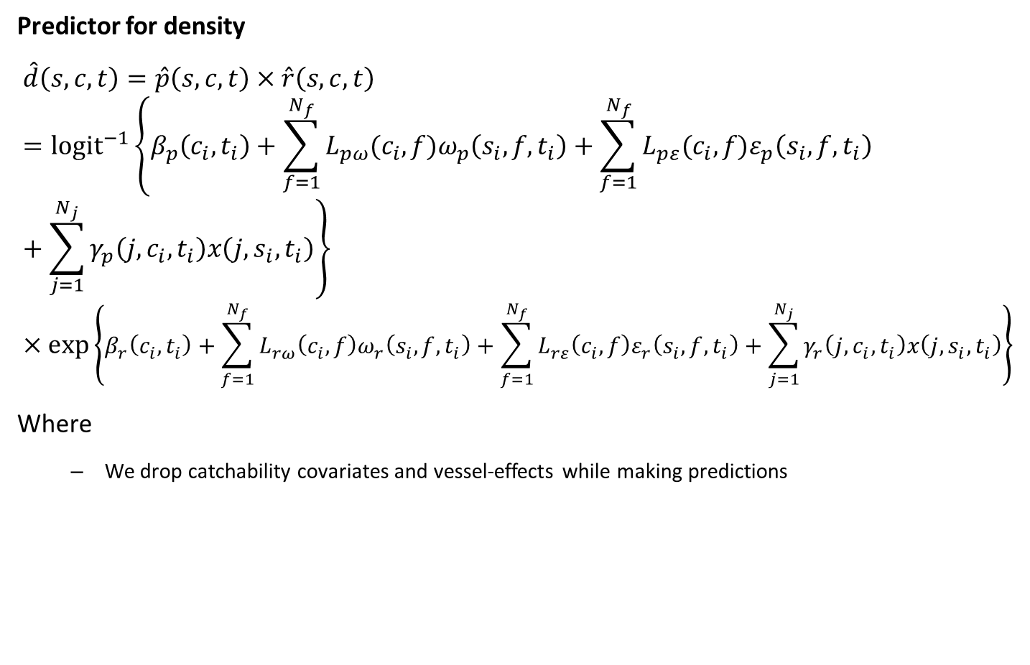
Geostatistical tool
Predictor for density
$$\hat{d}\left(s,c,t\right)=\hat{p}\left(s,c,t\right)×\hat{r}\left(s,c,t\right)={logit}^{−1}\left\{β_{p}\left(c_{i},t_{i}\right)+\sum_{f=1}^{N_{f}}{L_{pω}(c_{i}, f)ω_{p}\left(s_{i},f,t_{i}\right)}+\sum_{f=1}^{N_{f}}{L_{pε}(c_{i}, f)ε_{p}\left(s_{i},f,t_{i}\right)}+\sum_{j=1}^{N_{j}}{γ_{p}\left(j,c_{i}, t_{i}\right)x\left(j,s_{i},t_{i}\right)}\right\}×\exp\left\{β_{r}\left(c_{i},t_{i}\right)+\sum_{f=1}^{N_{f}}{L_{rω}\left(c_{i}, f\right)ω_{r}\left(s_{i},f,t_{i}\right)}+\sum_{f=1}^{N_{f}}{L_{rε}\left(c_{i}, f\right)ε_{r}\left(s_{i},f,t_{i}\right)}+\sum_{j=1}^{N_{j}}{γ_{r}\left(j,c_{i}, t_{i}\right)x\left(j,s_{i},t_{i}\right)}\right\}$$
Where
We drop catchability covariates and vessel-effects while making predictions

Slide 18
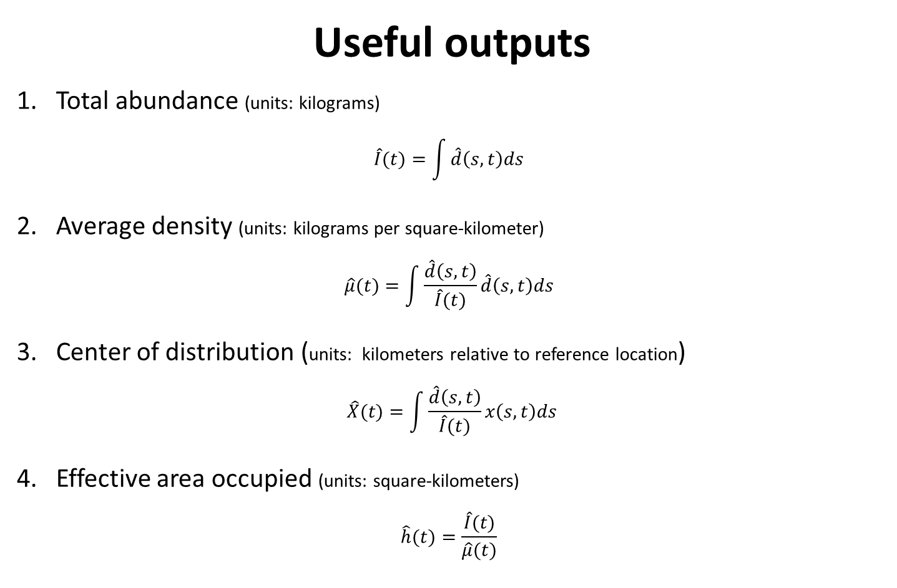
Geostatistical tool
Useful outputs
1. Total abundance (units: kilograms)
$$\hat{I}(t)=\int{\hat{d}\left(s,t\right)ds}$$
2. Average density (units: kilograms per square-kilometer)
$$\hat{μ}(t)=\int{\frac{\hat{d}\left(s,t\right)}{\hat{I}(t)}\hat{d}\left(s,t\right)ds}$$
3. Center of distribution (units: kilometers relative to reference location)
$$\hat{X}(t)=\int{\frac{\hat{d}\left(s,t\right)}{\hat{I}(t)}x\left(s,t\right)ds}$$
4. Effective area occupied (units: square-kilometers)
$$\hat{h}(t)=\frac{\hat{I}(t)}{\hat{μ}(t)}$$

Slide 19
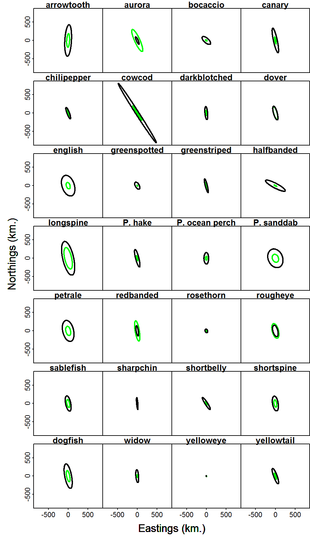
Geostatistical tool
Geometric anisotropy is important
Green: presence/absence; black: positive

